Slide 1
Composite Pattern

Slide 2
Intent
Compose objects into tree structures to represent whole-part hierarchies. Composite lets clients treat individual objects and compositions of objects uniformly.
Recursive composition
1-to-many "has a" up the "is a" hierarchy

Slide 3
Problem
Application needs to manipulate a hierarchical collection of "primitive" and "composite" objects. Processing of a primitive object is handled one way, and processing of a composite object is handled differently. Having to query the "type" of each object before attempting to process it is not desirable.

Slide 4
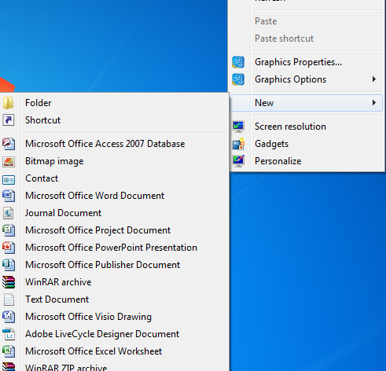
Example #1
Menus that contain menu items, each of which could be a menu.

Slide 5
Example #2
A GUI system has window objects which can contain various GUI components (widgets) such as, buttons and text areas. A window can also contain widget container objects which can hold other widgets.

Slide 6
Example #3
Directories that contain files, each of which could be a directory.

Slide 7
Example #4
Arithmetic expressions are Composites. An arithmetic expression consists of an operand, an operator (+ - * /), and another operand. The operand can be a number, or another arithmetic expression. Thus, 2 + 3 and (2 + 3) + (4 * 6) are both valid expressions.

Slide 8
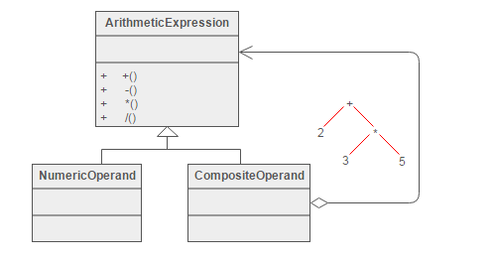
Structure of the Pattern

Slide 9
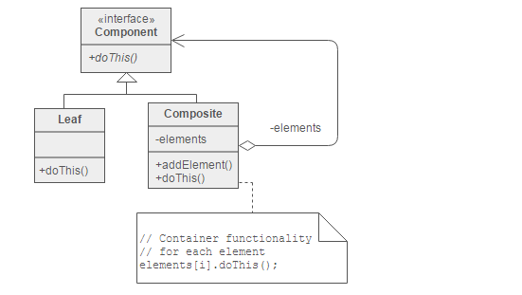
Structure

Slide 10
STATE Pattern

Slide 11
General Description
A type of Behavioral pattern.
Allows an object to alter its behavior when its internal state changes. The object will appear to change its class.
Uses Polymorphism to define different behaviors for different states of an object.

Slide 12
When to use STATE pattern ?
State pattern is useful when there is an object that can be in one of several states, with different behavior in each state.
To simplify operations that have large conditional statements that depend on the object’s state.
if (myself = happy) then
{
eatIceCream();
….
}
else if (myself = sad) then
{
goToPub();
….
}
else if (myself = ecstatic) then
{
….

Slide 13
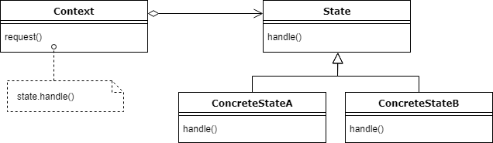
UML Diagram

Slide 14
Example I
water
StateOfWater
state variable
increaseTemp()
decreaseTemp()
increaseTemp()
decreaseTemp()
WaterVapor
LiquidWater
Ice
Client
increaseTemp()
increaseTemp()
decreaseTemp()
increaseTemp()
decreaseTemp()
increaseTemp()
decreaseTemp()

Slide 15
How is STATE pattern implemented ?
“Context” class:
Represents the interface to the outside world.
“State” abstract class:
Base class which defines the different states of the “state machine”.
“Derived” classes from the State class:
Defines the true nature of the state that the state machine can be in.
Context class maintains a pointer to the current state. To change the state of the state machine, the pointer needs to be changed.

Slide 16
Example II
MyMood
MoodState
state variable
doSomething()
mad
angry
happy
Client
doSomething()
doSomething()
doSomething()
doSomething()

Slide 17
Benefits of using STATE pattern
Localizes all behavior associated with a particular state into one object.
New state and transitions can be added easily by defining new subclasses.
Simplifies maintenance.
It makes state transitions explicit.
Separate objects for separate states makes transition explicit rather than using internal data values to define transitions in one combined object.
State objects can be shared.
Context can share State

Slide 18
Home Work
Understand the implementation of the “Composite and State” pattern using following link:
1. Composite Pattern:
https://sourcemaking.com/design_patterns/composite
2.State Pattern:
https://sourcemaking.com/design_patterns/state

